Slide 1
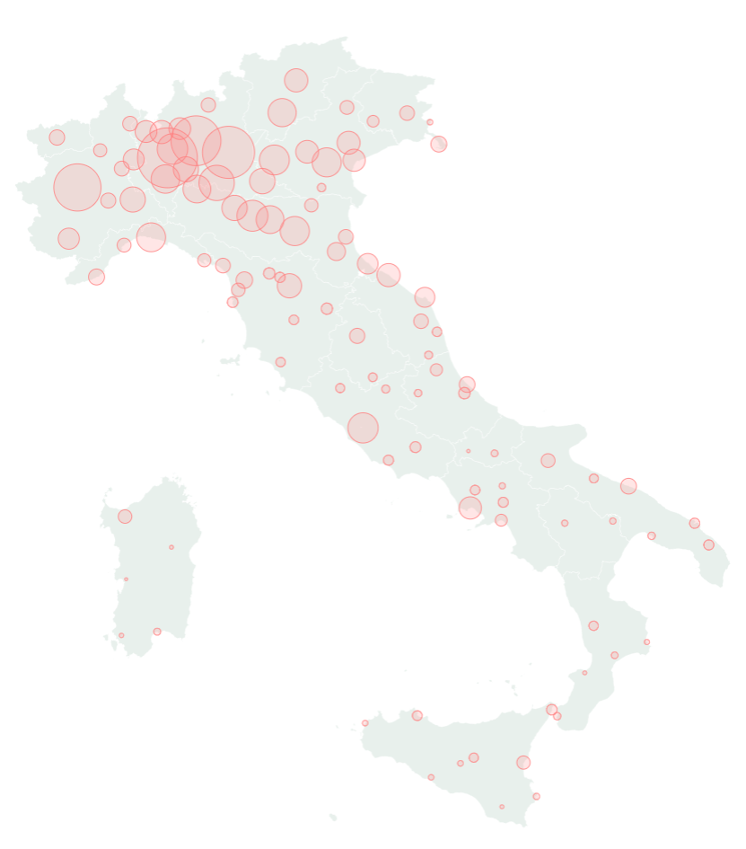
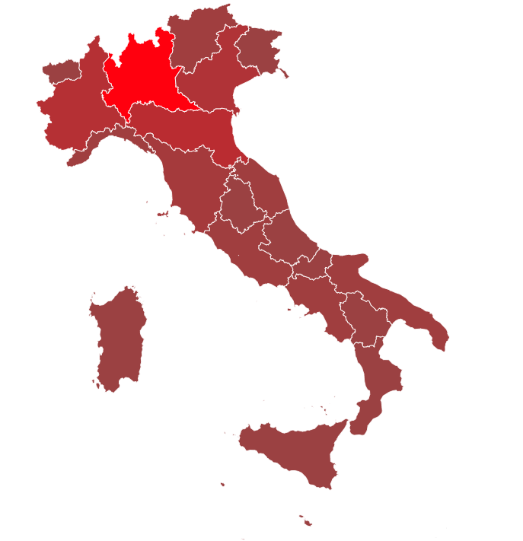
Italy: workers' struggles in the coronavirus crisis
Mauro Vanetti, IMT organiser in Pavia, Lombardy

Slide 2
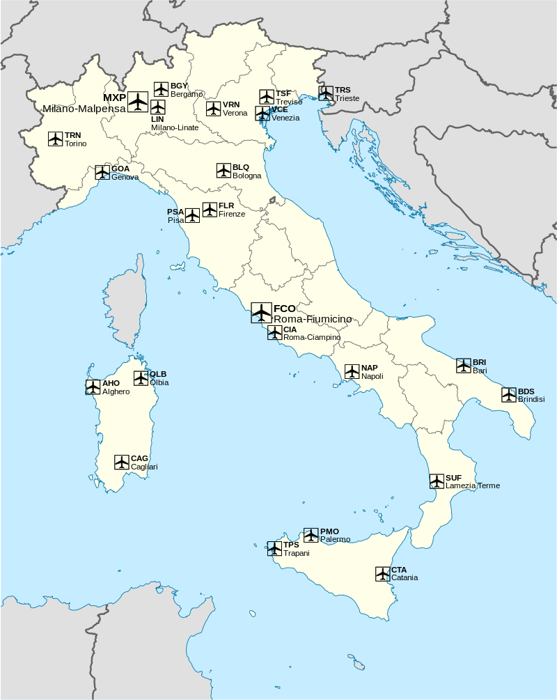
Timeline of the outbreak: January 31st
Rome: first 2 cases (traced back to China, isolated)
All flights to/from China suspended (contrary to WHO recommendation)
6 months state of emergency declared

Slide 3
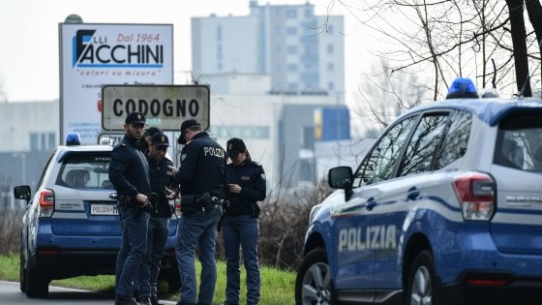
Timeline of the outbreak: February 19th
First cluster in Codogno, Lombardy
Hunt for patient zero
Later in February, another cluster in Veneto

Slide 4
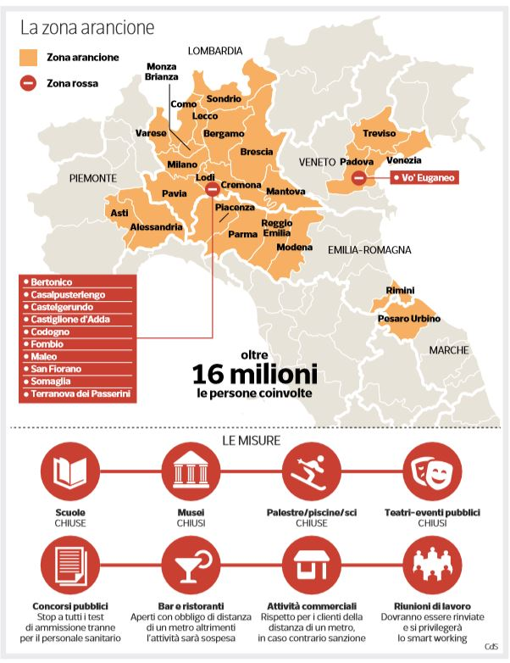
Timeline of the outbreak: February 22nd
11 red zones (50,000 people)
Orange zones (16,000,000 people)
Ban on leisure gatherings (theatres, cinemas, museums etc.)
Restaurants, bars, pubs partially closed
Work from home «whenever possible»
Schools + universities closed

Slide 5
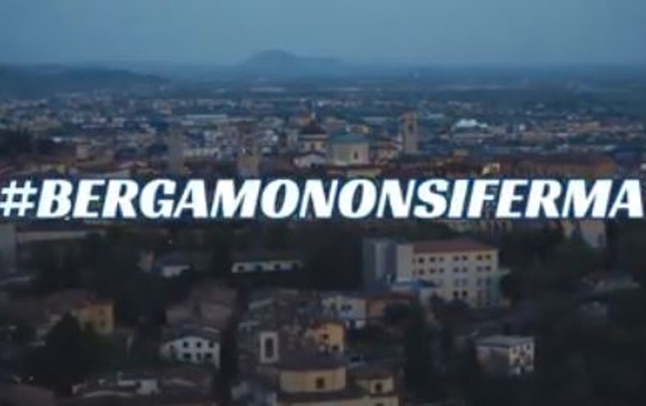
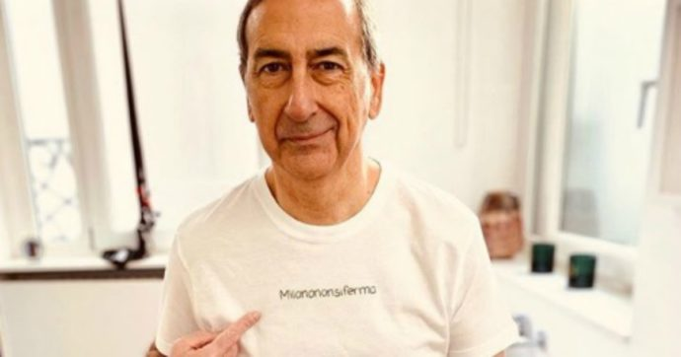
Can't stop it
Local politicians, bosses' and shop owners' associations organise resistance against slowdown measures

Slide 6
Timeline of the outbreak: March 7th
Lockdown in the yellow zones
Movement allowed only for:
Basic needs (food, medications)
Proven working needs (self-certified)
Emergencies
Prison riots
March 9th: nationwide lockdown

Slide 7
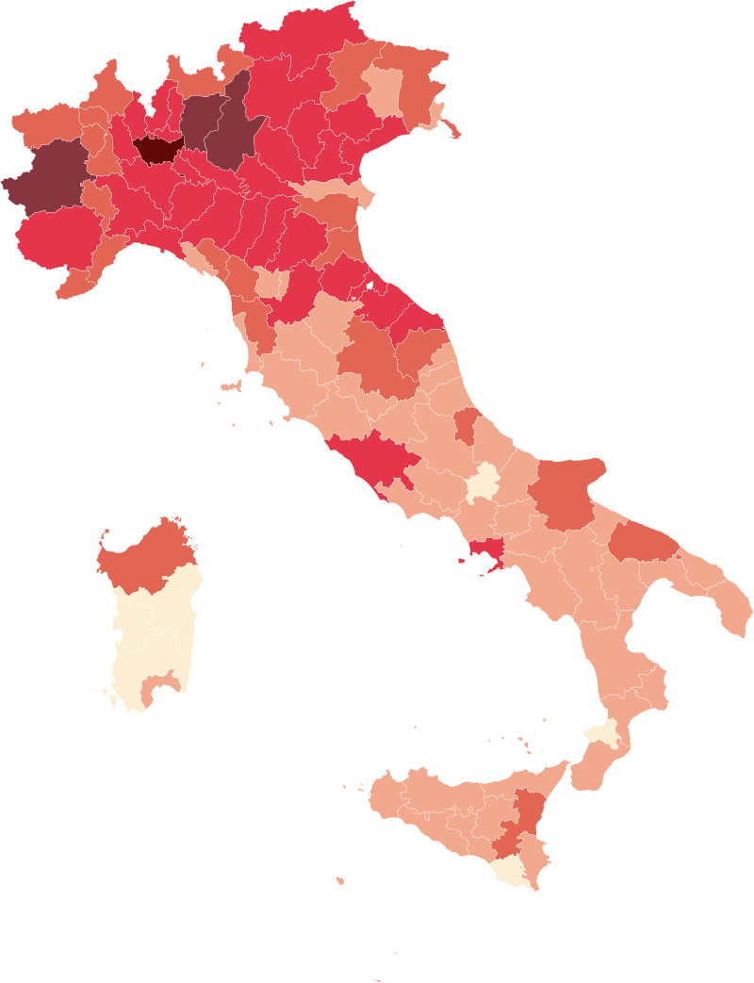
«Stay home»! But…
Dense industrial areas such as Bergamo, Brescia, Turin, Milan hit harder
Cuts, privatisation, mismanagement, lack of planning, disdain for healthcare workers' welfare → hospitals become hubs for virus spread

Slide 8
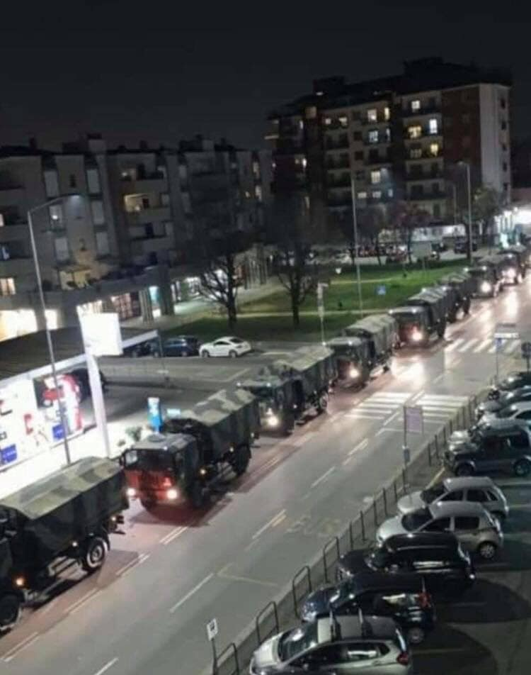
Timeline of the outbreak: March 21st
"Non-essential productions suspended"
Actually…
Essential business sectors → open
Sectors arbitrarily declared essential → open
Suppliers of essential sectors → also open
Can work from home → open
Military trucks moving corpses out of
Bergamo, Lombardy

Slide 9
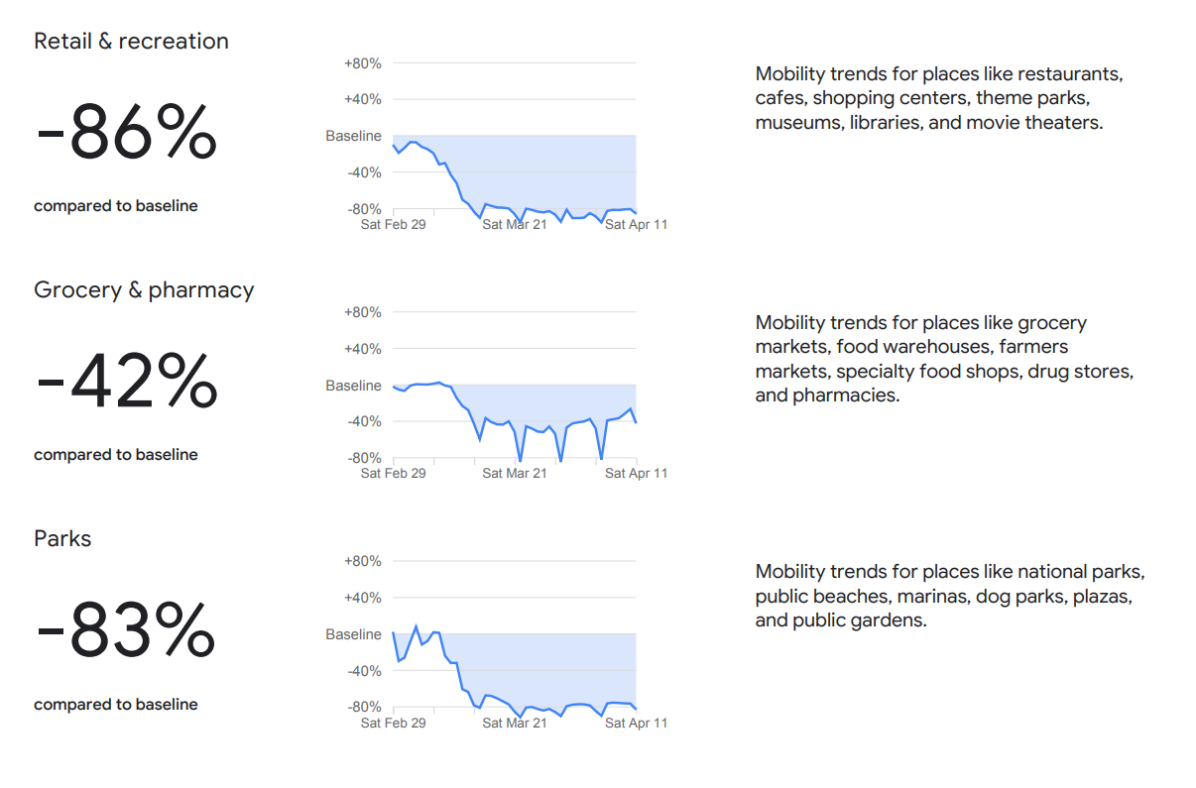
Daily life of working-class families

Slide 10
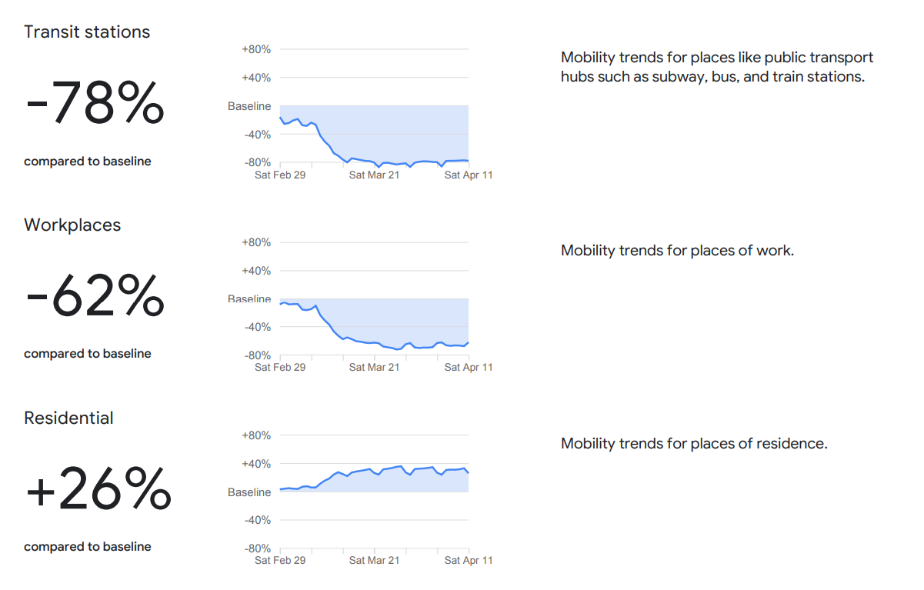
Daily life of working-class families

Slide 11
Class struggle over plant closures
The Force Awakens Wildcat strikes → TU-bosses protocol agreed upon
A New Hope More strikes → closures decree
The Empire Strikes Back Workplaces reopen through loopholes and exceptions
The Phantom Menace TU bureaucracy threatens general strike → improved decree, more closures
Revenge of the Sith Bosses pressure government → reopening decree ("expert" committee lead by millionaire)
Return of the Jedi …to be continued

Slide 12
«Workers are not expendable»

Slide 13
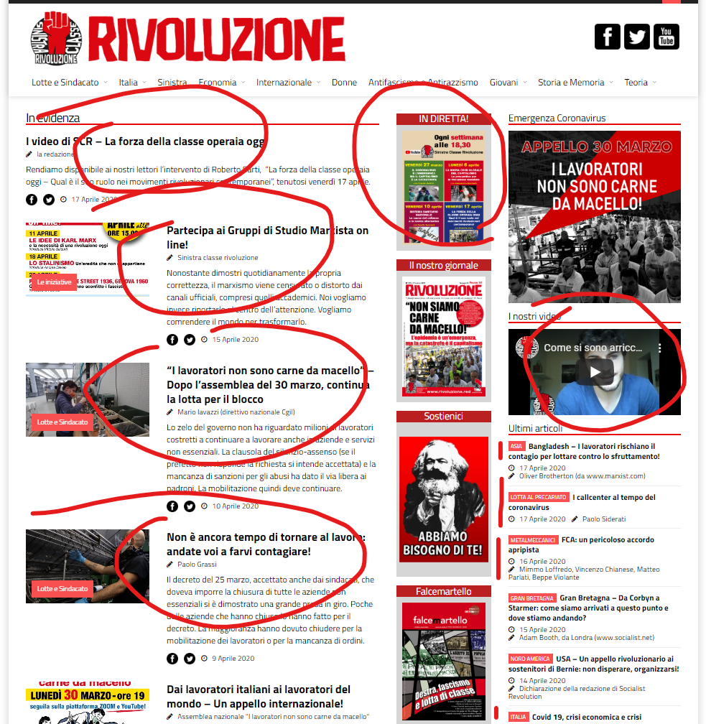
Switching political work to pandemic mode
Organise the outrage in factories + other workplaces
Online meetings
Reports from life and work under lockdown
Loads of education videos
Stricter finances → please donate!
Eye-opening for many people → join us!

